Slide 1
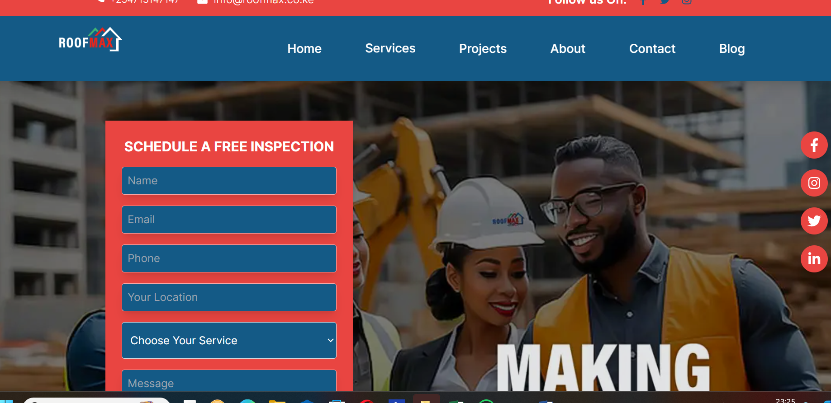
GET A FREE QUOTATION

Slide 2

Keep photos coloured

Slide 3
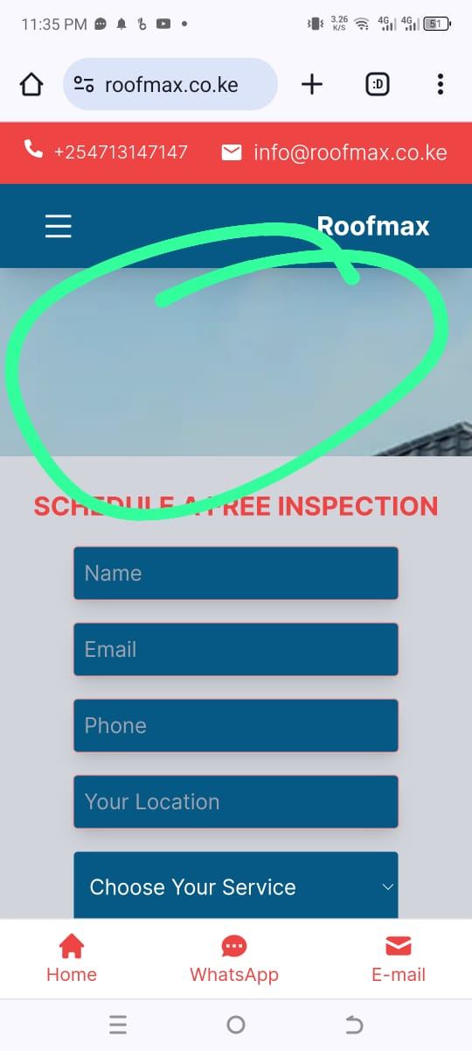
Update photo on mobile

Slide 4
Link WhatsApp link email

Slide 5
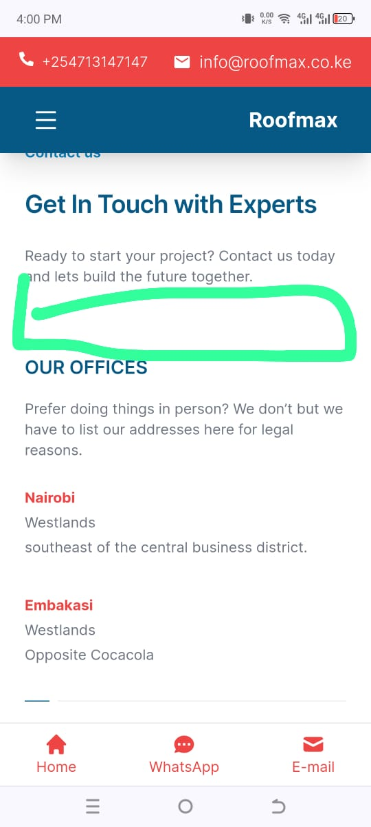
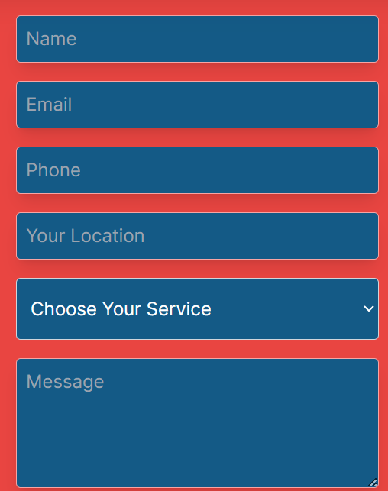

Slide 6
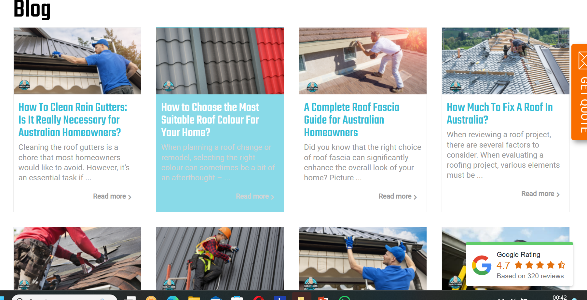
Blog Layout

Slide 7
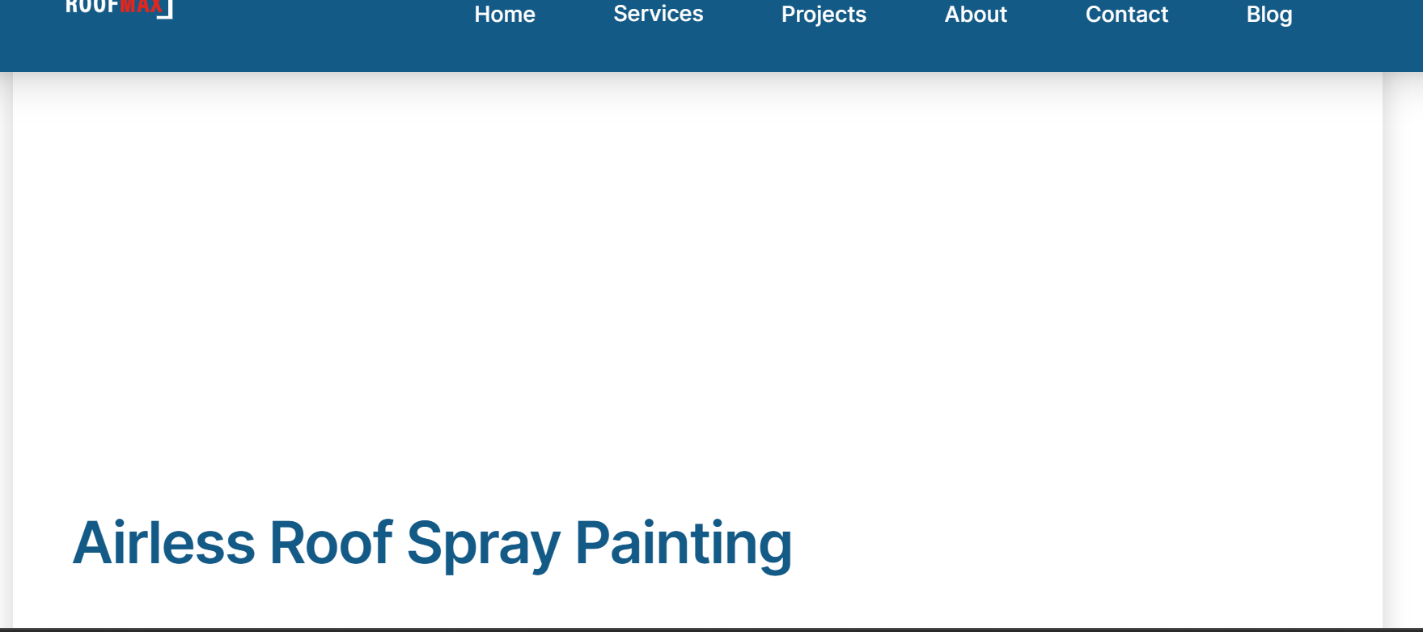
Loading of images

